Slide 1
Network Biosignatures of Earth’s Atmosphere and Biosphere
C. Ruiz, T. Fisher, S.I. Walker

Slide 2
What distinguishes our living world
from non-living worlds?
Oxygen and H2O are obvious indicators
However, not necessarily indicative of life
How can we use presence of oxygen and H2O as a potential biosignature?
Notes:
The presence of oxygen and water are used as possible indicators of life on other planets - but presence does not necessarily mean there is life on that planet. So now the question becomes, how can we use the presence of oxygen and water as a potential biosignature on another planet?

Slide 3
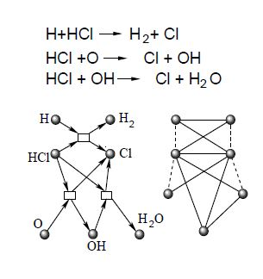
Graphical Representation of Atmospheric Chemical Networks
Products and Reactants: Nodes
Reaction between the two: Edges
Sole and Munteanu. (2004) The large-scale organization of chemical reaction networks in astrophysics. Europhysics Letters 68.2: 170.
Notes:
The presence of oxygen and water in a planet’s atmosphere will soon be able to be detected from instruments such as the James Webb Space Telescope, and one of the possible ways in which we can use these things as an indicator of life is through putting atmospheres in graphical representations, such as networks. Here we have an example of how networks in this frame work: the nodes are each a different molecular species, which are connected according to which molecules they react with and produce. So let’s take the first equation, H connects to Cl, which produces HCl, which in turn is connected to H2 and Cl through its own path. This framework allows us to do statistical analysis on the structure of an atmosphere, which leads us into what my project is working to do.

Slide 4
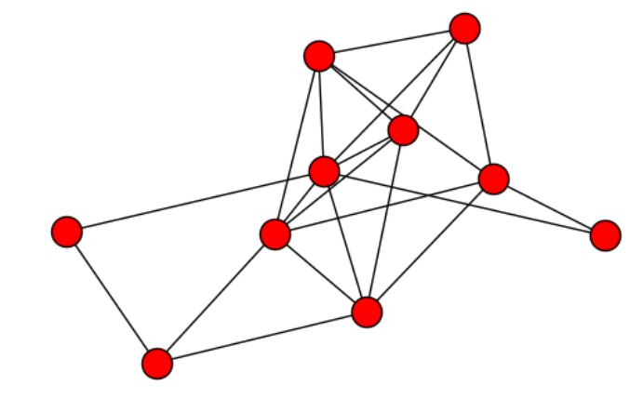
Scale-Free vs. Random Networks
Scale-Free
Clearly organized in some systematic structure
Biochemical networks look closer to this
Random
No clear system or structure, definitely random
Networks of non-living worlds look closer to this
Notes:
In knowing this information, Earth’s atmosphere and biosphere can be plotted on networks like these. Previous works have indicated a clear difference between a planet with a global biosphere (Earth) and without a global biosphere (like Mars). My work is looking specifically at why the presence of oxygen plays a role in the structure of these networks, and what Earth’s analysis would look like without oxygen. This will further the implication that future scientists may be able to use this theory as a means of detecting biosignatures on other planets.

Slide 5
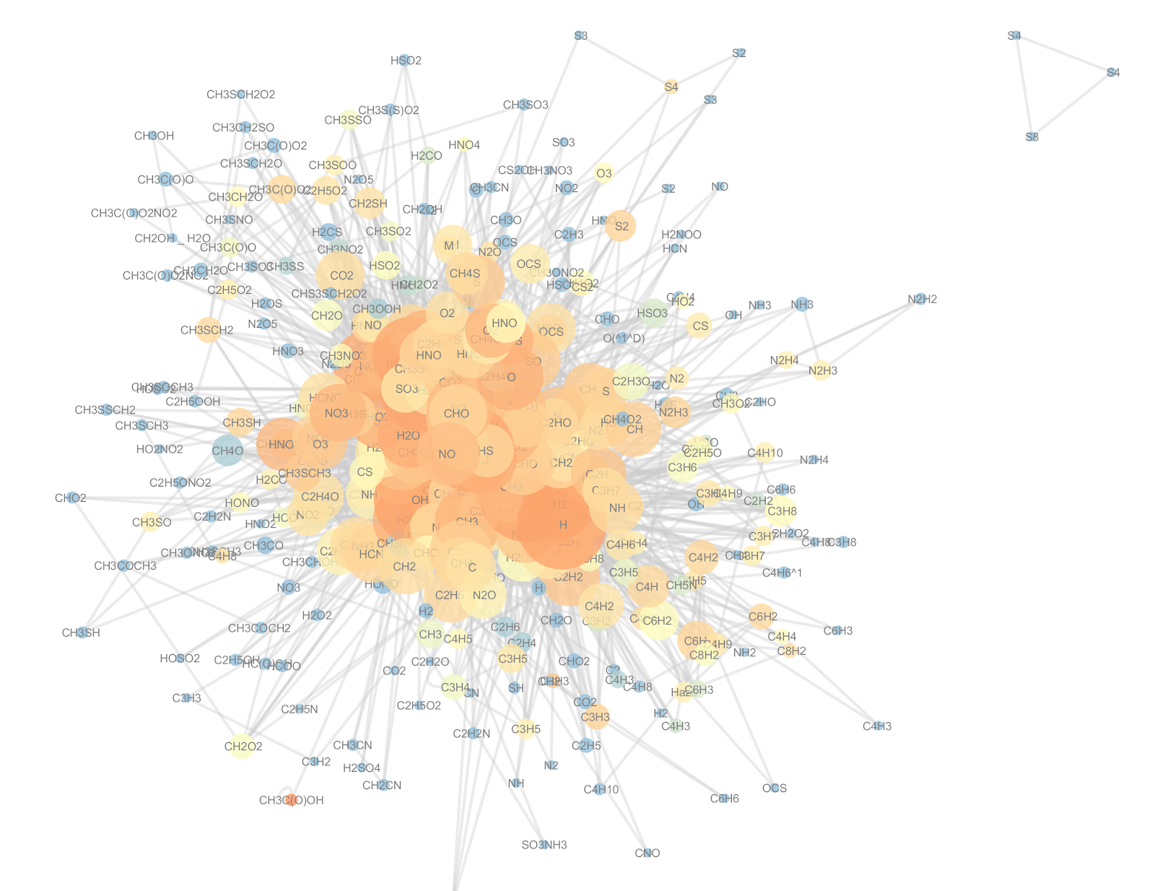
Earth’s Stratosphere
Notes:
This is what Earth’s stratosphere looks like when put into a network. The size of the nodes indicates the degree of the node - in other words, how many connections it has to other nodes. This is indicative of how many reactions that molecular species is involved in. The color ranges from red to blue, and the shade is indicative of that molecule’s clustering coefficient, or in other words, the degree to which the neighbors of a given node link to each other.

Slide 6
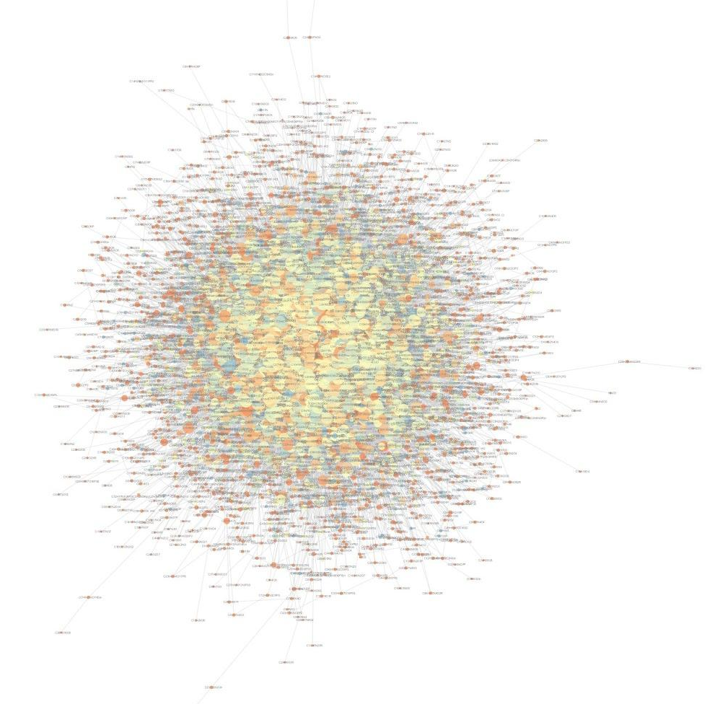
Earth’s Biosphere - KEGG Network
Notes:
And this, is what Earth’s biosphere looks like when plotted into a network, in the same organizational structure as Earth’s stratosphere.

Slide 7
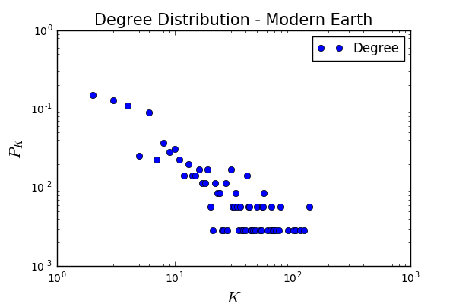
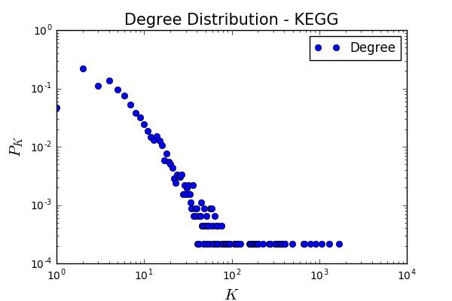
Degree Distribution
Earth’s Stratosphere
Earth’s Biosphere - KEGG Network

Slide 8
Statistical Analysis of Networks
 | EA - Oxygen | EA - All | EB - Oxygen | EB - All
Mean Degree | 16.229 | 15.841 | 9.933 | 9.892
Average Clustering Coefficient | 0.7186 | 0.6963 | 0.3206 | 0.3199
Assortativity Coefficient | -0.2438 | -- | -0.2369 | --
Average Neighbor Degree | 57.3 | 54.2 | 318.2 | 316.9
Betweenness | 0.00397 | -- | 0.0004 | --
Notes:
From analyzing all kinds of statistical measurements of these networks, here are some of the measurements that have been taken of Earth’s atmosphere and biosphere. There are differences in the different properties of just oxygen nodes vs. all the nodes. This is indicative of oxygen affecting the overall measurements of these properties.

Slide 9



Thanks!
Any questions?

Slide 10
Presentation design
This presentations uses the following typographies and colors:
Titles: Roboto Slab
Body copy: Source Sans Pro
You can download the fonts on these pages:
https://www.fontsquirrel.com/fonts/roboto-slab
https://www.fontsquirrel.com/fonts/source-sans-pro
Blue #0091ea
Dark gray #263238
Medium gray #607d8b
Light gray #cfd8dc
You don’t need to keep this slide in your presentation. It’s only here to serve you as a design guide if you need to create new slides or download the fonts to edit the presentation in PowerPoint®

Slide 11
SlidesCarnival icons are editable shapes.
This means that you can:
Resize them without losing quality.
Change line color, width and style.
Isn’t that nice? :)
Examples:

